Slide 1
OMOP Common Data Model Extract, Transform & Load Tutorial
Clair Blacketer
Mui van Zandt
Erica A. Voss

Slide 2
What this tutorial will provide . . .
Suggested process for developing a CDM ETL
OHDSI ETL tools: White Rabbit, Rabbit-In-A-Hat, and Usagi
Resources like the CDM Wiki and THEMIS
Generation of a simple ETL

Slide 3
Agenda
Time | Agenda Item
9:00 – 9:30 | Overview VM Set Up What is OHDSI / CDM? What is the ETL Process?
9:30 – 10:45 | ETL Step 1 – Design Your ETL
10:45 – 11:15 | Coffee
11:15 – 12:30 | ETL Step 2 – Mapping to the Vocabulary
12:30 – 13:30 | Lunch
13:30 – 14:30 | ETL Step 3 – Develop ETL
14:30 – 15:30 | ETL Step 4 – Quality Control
15:30 – 16:00 | Coffee Break
16:00 – 17:00 | ETL Pain Points & Conclusions
17:00 – 18:00 | Beer, Wine, & Snacks

Slide 4



Instructors
Clair Blacketer | Mui van Zandt
Erica Voss

Slide 5

Ground Rules
We are recording this presentation for future use
We may take some questions off-line if too specific

Slide 6






OHDSI in a Box
Raw Lauren
PostgreSQL
CDM Lauren (EMPTY)
cdm
webapi
Atlas
Raw Synthea
WebTools
WebAPI
CDM Synthea
PGAdmin4
Tomcat
CDM Synpuf (100K)
Methods Library
WhiteRabbit
OHDSI R packages
Studio
Usagi

Slide 7
Directions for Accessing a VM
LINK TBD
Pick one of the rows and put your name on the second column
Go to c:/windows/system32 and click mstc.exe
Username: erasmusmc
Password: 123beter

Slide 8
OHDSI’s Mission & Vision
To improve health by empowering a community to collaboratively generate the evidence that promotes better health decisions and better care.
A world in which observational research produces a comprehensive understanding of health and disease.
Join us on the journey
http://ohdsi.org

Slide 9

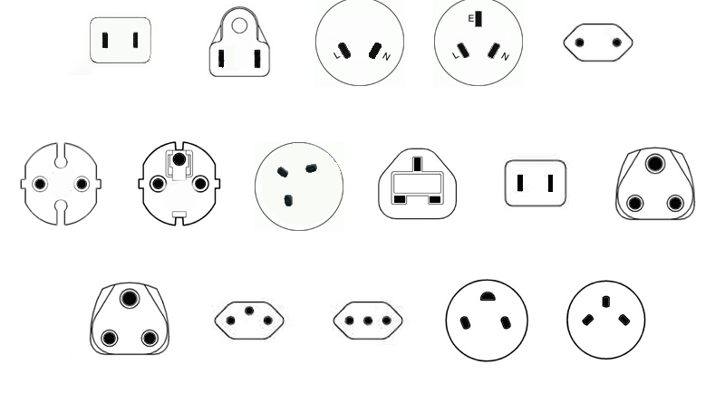
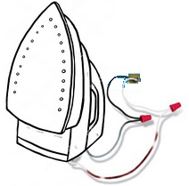
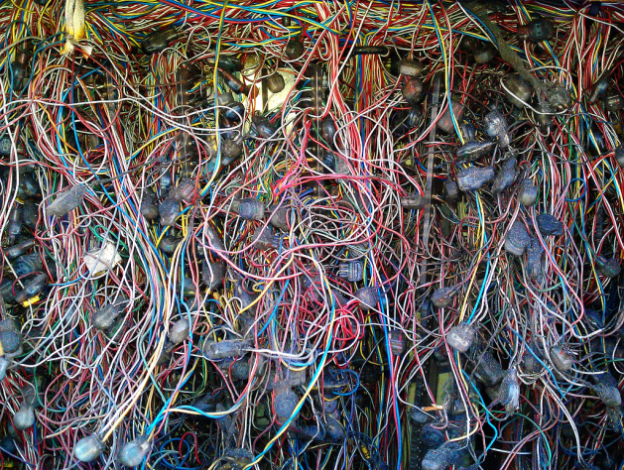
Current Approach: “One Study – One Script“
"What's the adherence to my drug in the data assets I own?"
Current solution:
Analytical method: Adherence to Drug
North America
Southeast Asia
China
Europe
UK
Japan
India
Application to data
Switzerland
Italy
So Africa
Israel
Not scalable
Not transparent
Expensive
Slow
Prohibitive to non-expert routine use
One SAS or R script for each study

Slide 10



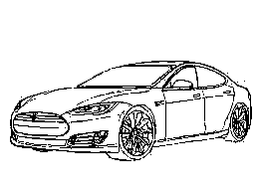
Solution: Data Standardization Enables Systematic Research
Adherence
Mortality
Source of Business
North America Southeast Asia China
Europe UK Japan India
So Africa Switzerland Italy Israel
Safety Signals
Standardized data
OHDSI Tools OMOP CDM

Slide 11
CDM Version 6 Key Domains
Person
Standardized health system data
Standardized metadata
Observation_period
CDM_source
Location
Standardized vocabularies
Visit_occurrence
Metadata
Location_history
Visit_detail
Standardized derived elements
Care_site
Condition_occurrence
Provider
Drug_exposure
Concept
Procedure_occurrence
Vocabulary
Device_exposure
Condition_era
Standardized clinical data
Domain
Drug_era
Measurement
Concept_class
Dose_era
Note
Standardized health economics
Concept_relationship
Results Schema
Note_NLP
Cohort
Relationship
Survey_conduct
Cohort_definition
Concept_synonym
Observation
Concept_ancestor
Specimen
Cost
Source_to_concept_map
Fact_relationship
Payer_plan_period
Drug_strength

Slide 12
Why the CDM?
Ability to pursue cross-institutional collaborations
Write one program to run on multiple data assets
OMOP Vocabularies has greatly increased our ability to find relevant codes
You truly know your data if you convert it to the CDM
If you know a problem with your data, you can use the ETL to address it
Whole community of researchers across diverse organizations and countries
You can use standardized tools developed by OHDSI like ATLAS and the Patient Level Prediction Package
The CDM brings consistency to observational research through
standardization of many of its components
Buy vs Build: leverage an entire community of technical and scientific capability for “free”
Takes observational research towards open science

Slide 13
Why the CDM?
Regulator | Data Source Owners | Small to Medium Enterprises
Increased capacity to carry out studies with big geographical coverage Increased capacity to look at patients holistically across health systems Easier assessment of data quality | Facilitates scientific collaboration by becoming part of a thriving network Increased analysis capability thanks to a host of open source tools to use Faster performing studies, more studies in less time. | Opportunity to change paradigm benefitting health of citizens Expand your existing market Open source community boosts opportunities

Slide 14
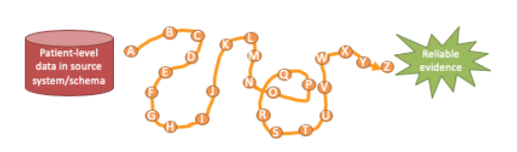
ETL
Extract, Transform, Load
In order to get from our native/raw data into the OMOP CDM we need to design and develop and ETL process
Goal in ETLing is standardize the format and terminology
This tutorial
Will teach you best practices around designing an ETL and CDM maintenance
Will not teach you how to program an ETL

Slide 15








ETL Process
ETL Documentation
ETL
Data experts and CDM experts together design the ETL
People with medical knowledge create the code mappings
All are involved in quality control
A technical person implements the ETL
OHDSI Tools
White
Rabbit
Rabbit In a Hat
Usagi
White
Rabbit
ACHILLES
Rabbit In a Hat

Slide 16
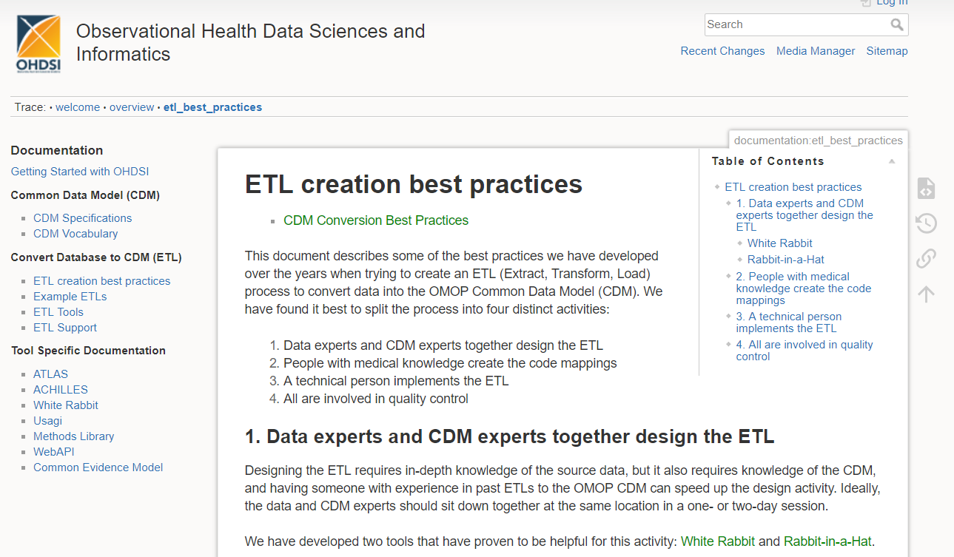
ETL Process
http://www.ohdsi.org/web/wiki/doku.php?id=documentation:etl_best_practices

Slide 17

Hands On Exercises for Today
Scan a database with White Rabbit
Build a ETL document with Rabbit in a Hat
Mapping Source Codes by with the OMOP Vocabulary and USAGI
SQL to build an ETL

Slide 18
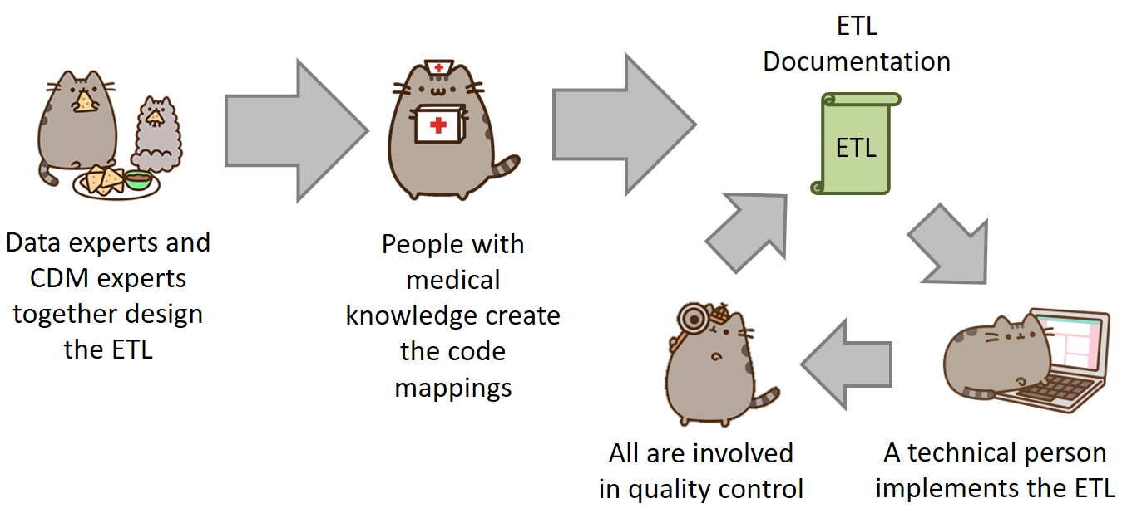

Slide 19



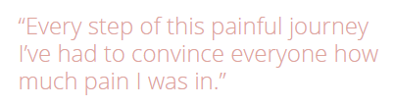
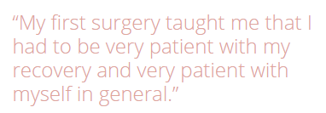
A Patient’s Story: Lauren
https://www.endometriosis-uk.org/laurens-story

Slide 20

What data do we have?
dysmenorrhea
abdominal pain
missed work
missed work
acetaminophen
acetaminophen
acetaminophen
GP visit
ultrasound
pelvic exam
cyst of ovary
Hospital Visit
severe pain
temp 103°F
CT Scan
ambulance
Bloated abdomen
ascites
surgery
endometrioma
Lauren’s Timeline
Endometriosis
/ /
/ /
-3 Years
-2 Years
-1 Years
-2 Weeks
-3 Days
Day 0

Slide 21
Data Format
SyntheaTM is a Synthetic Patient Population Simulator. The goal is to output synthetic, realistic (but not real), patient data and associated health records in a variety of formats.
The resulting data is free from cost, privacy, and security restrictions. It can be used without restriction for a variety of secondary uses in academia, research, industry, and government (although a citation would be appreciated).
https://github.com/synthetichealth/synthea
Walonoski J, Kramer M, Nichols J, Quina A, Moesel C, Hall D, Duffett C, Dube K, Gallagher T, McLachlan S. Synthea: An approach, method, and software mechanism for generating synthetic patients and the synthetic electronic health care record. J Am Med Inform Assoc. 2017 Aug 30. doi: 10.1093/jamia/ocx079. [Epub ahead of print] PubMed PMID: 29025144.

Slide 22
Synthea Tables
File | Description
allergies.csv | Patient allergy data.
careplans.csv | Patient care plan data, including goals.
conditions.csv | Patient conditions or diagnoses.
encounters.csv | Patient encounter data.
imaging_studies.csv | Patient imaging metadata.
immunizations.csv | Patient immunization data.
medications.csv | Patient medication data.
observations.csv | Patient observations including vital signs and lab reports.
organizations.csv | Provider organizations including hospitals.
patients.csv | Patient demographic data.
procedures.csv | Patient procedure data including surgeries.
providers | Clinicians that provide patient care.

Slide 23

Raw Data
raw_lauren
raw_synthea
1 Patient
Lauren Data
Synthea Format
1000 Patient
Synthetic Data
Synthea Format

Slide 24
Tools help us get started . . .
White Rabbit
Rabbit In a Hat
performs a scan of the source data, providing detailed information on the tables, fields, and values that appear in a field
Uses White Rabbit scan to provide a graphical user interface to help build an ETL document
Does not generate code

Slide 25
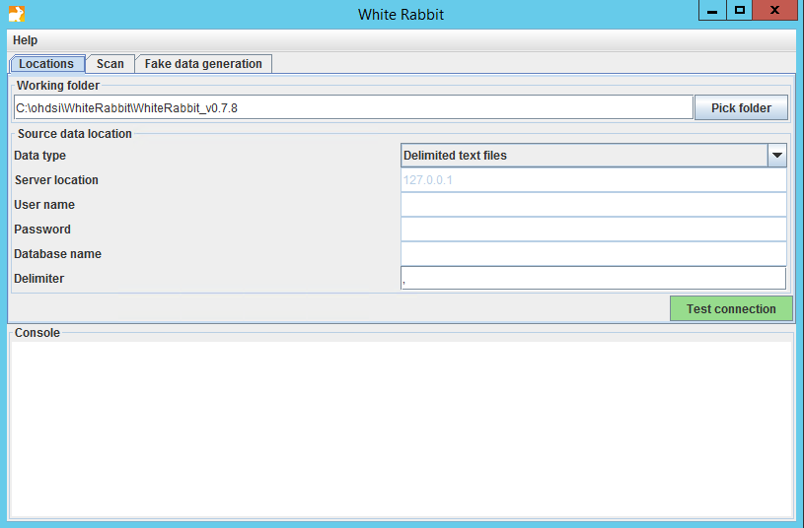
White Rabbit - Location

Slide 26
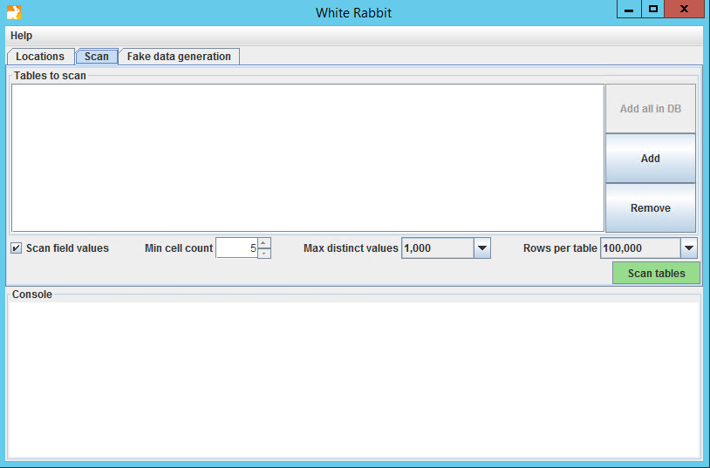
White Rabbit - Scan

Slide 27
White Rabbit - Scan

Slide 28
White Rabbit - Scan

Slide 29
White Rabbit – Scan Report
raw_synthea
We already ran the scan on raw_synthea
To open the scan while we review:
https://github.com/OHDSI/Tutorial-ETL
Materials → WhiteRabbit → ScanReport_raw_synthea.xlsx
Click “View Raw” to download the XLSX

Slide 30
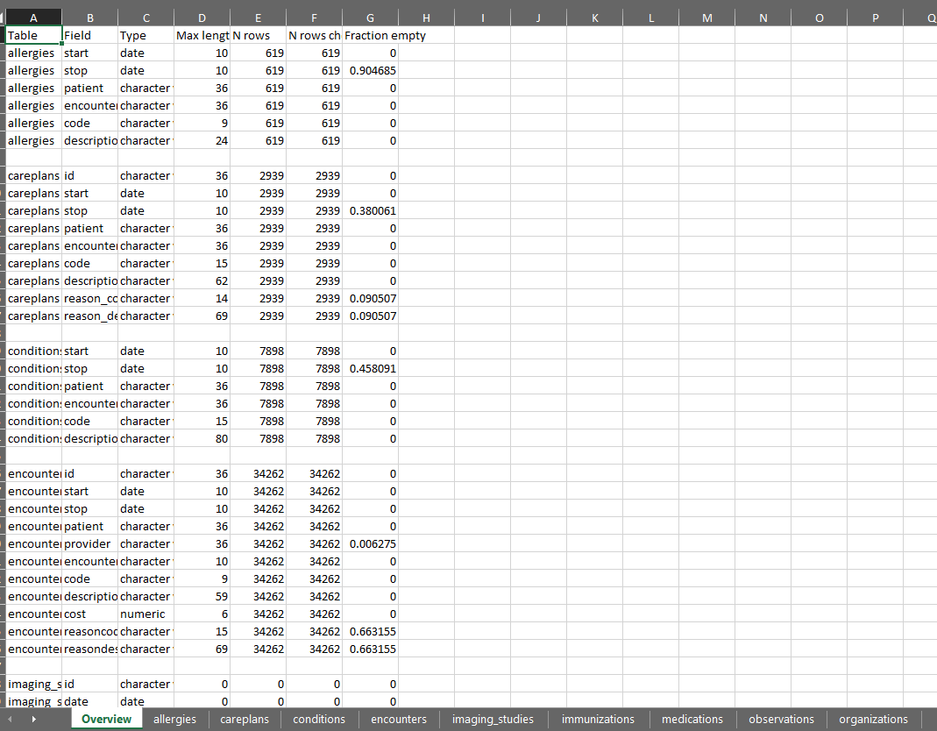
White Rabbit – Scan Report: raw_synthea
Overview Tab

Slide 31
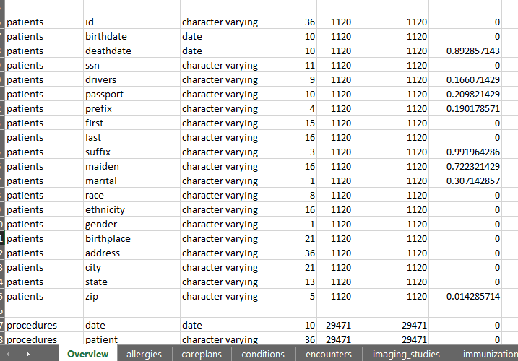
White Rabbit – Scan Report: raw_synthea
Overview Tab

Slide 32
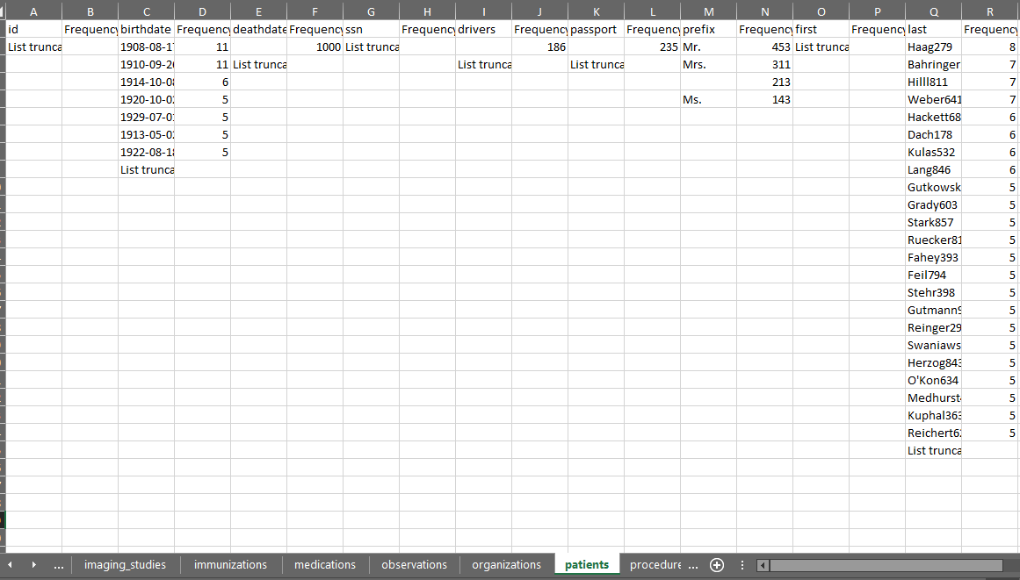
White Rabbit – Scan Report: raw_synthea
Patients Tab

Slide 33
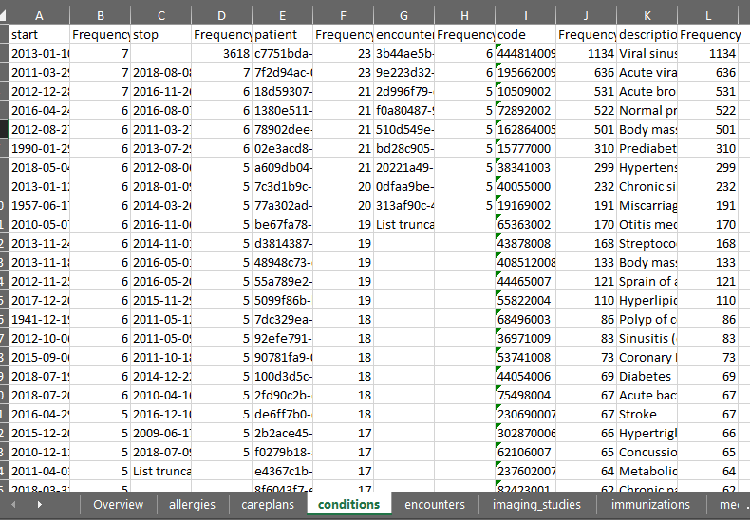
White Rabbit – Scan Report: raw_synthea
What can you learn about raw_synthea data just by looking at the conditions tab?
Conditions Tab

Slide 34
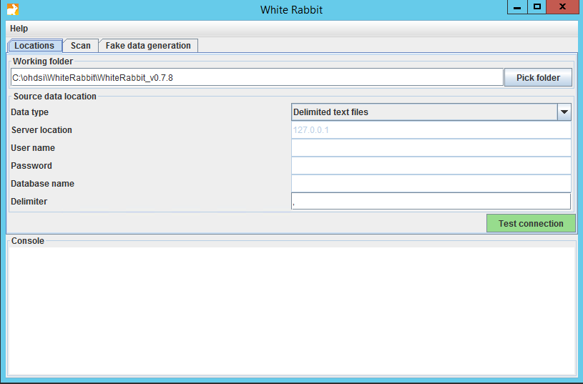
Now Your Turn: Scan Lauren’s Data
Click on WhiteRabbit shortcut
Go into the WhiteRabbit folder
Open WhiteRabbit.jar
raw_lauren

Slide 35
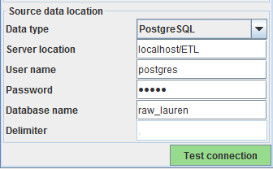
Now Your Turn: Scan Lauren’s Data
Connect to Lauren’s Data
Test connection
raw_lauren
ohdsi

Slide 36
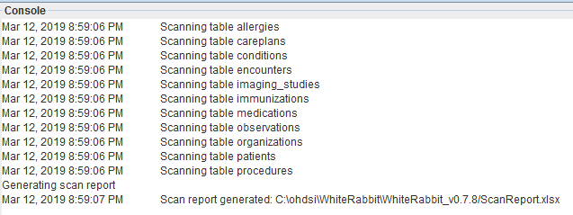
Now Your Turn: Scan Lauren’s Data
Go to the “Scan” tab
Press “Add all in DB” button, set “Min cell count” to 0, and then “Scan tables”
Open ScanReport.xlsx
raw_lauren

Slide 37
White Rabbit
White Rabbit creates an export of information about the source data
The scan can be used to:
Learn about your source data
Needed for Rabbit In a Hat

Slide 38
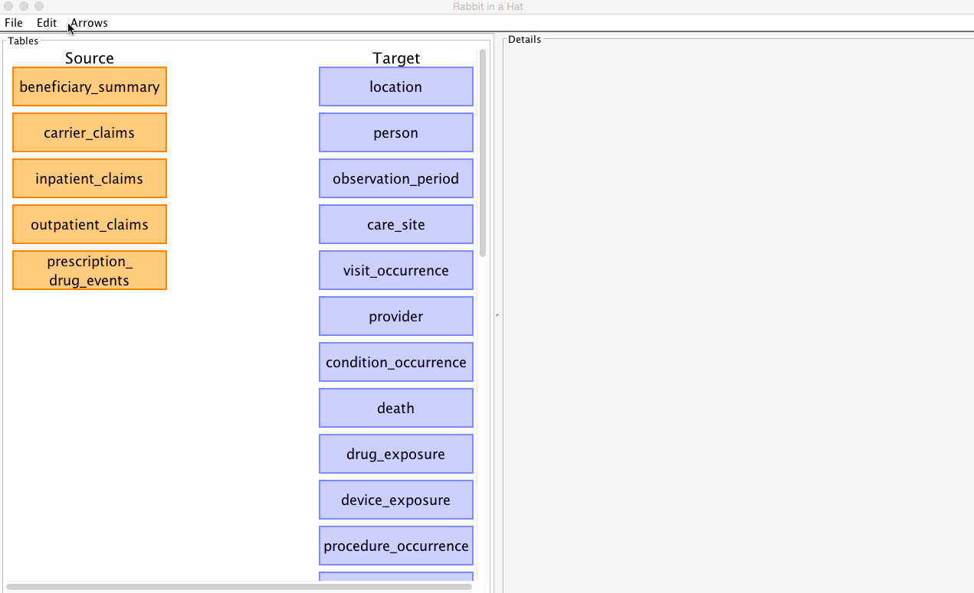
Rabbit in a Hat
Can read and display a White Rabbit scan document
Provides a graphical interface to allow a user to connect source data to tables

Slide 39
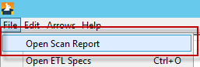
Rabbit in a Hat
raw_ synthea
We will use the ScanReport_raw_synthea.xlsx for this:
https://github.com/OHDSI/Tutorial-ETL
Materials → WhiteRabbit → ScanReport_raw_synthea.xlsx
Click “View Raw” to download the XLSX
Save it to the desktop
Open in Rabbit in a Hat

Slide 40
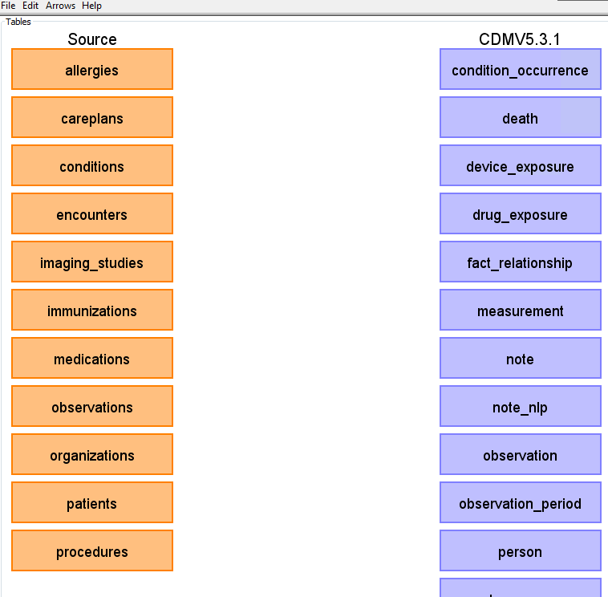
Rabbit in a Hat
The scan tells Rabbit in a Hat what is in the raw database
Orange Tables = Raw
Blue Tables = CDM

Slide 41
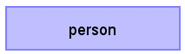
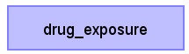
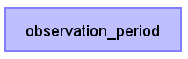

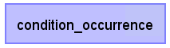
Rabbit in a Hat
Together
On your Own
Generate document

Slide 42

Resources
Important links to keep in mind when working on an ETL:
CDM Wiki https://github.com/OHDSI/CommonDataModel/wiki Information about the CDM structure and conventions to follow can be found here
OHDSI Forums http://forums.ohdsi.org/ http://forums.ohdsi.org/c/cdm-builders OHDSI is an active community, your questions may have already been asked on the forum however if not do not be afraid to ask it yourself!
CDM Examples http://www.ohdsi.org/web/wiki/doku.php?id=resources:2018_data_network About 100 CDMs currently exist
THEMIS Working Group https://github.com/OHDSI/Themis

Slide 43
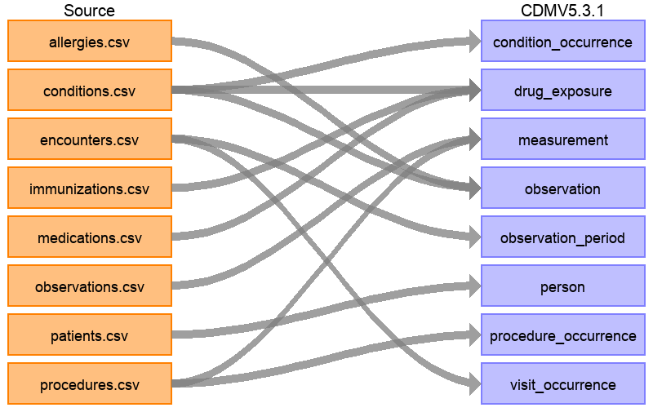
Rabbit in a Hat
The full ETL document: https://ohdsi.github.io/ETL-Synthea/

Slide 44
Some Parting Thoughts On ETL
Vocabulary will tell a source record where to go.
Example, just because it is a condition code and in a condition table does not mean it will end up in CONDITION_OCCURRENCE ICD9 781.1 - Abnormal weight gain
STEM Table in Rabbit In a Hat

Slide 46
Standardizing Terminologies
SOURCE_CODE
XYZ
i.e. ICPC-1 Dutch codes, ICD9, etc.
?
STANDARD_CONCEPT_ID
123456789
i.e. SNOMED for conditions and RxNorm for drugs
What is standardize:
TABLE_CONCEPT_ID standard concept the source code maps to, used for analysis
TABLE_SOURCE_CONCEPT_ID concept representation of the source code, helps maintain tie to raw data
Ways to get a source code to standard code:
OMOP Vocabulary
USAGI

Slide 47
OMOP Vocab
There are two standard queries to help us use the OMOP Vocabulary:
SOURCE_TO_STANDARD.sql
SOURCE_TO_SOURCE.sql
https://github.com/OHDSI/Tutorial-ETL
Materials → Queries

Slide 48
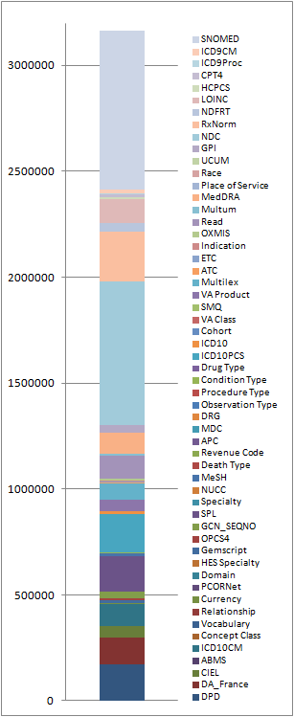
OMOP Vocab
If your source data’s codes are in the OMOP Vocab you can use it to translate to a standard
Synthea already speaks standard terminology:
Conditions = SNOMED
Drugs = RxNorm
Procedures = SNOMED
Observations = SNOMED

Slide 49
Mapping a Lauren Row to CONCEPT_ID
SELECT *
FROM RAW_LAUREN.CONDITIONS
WHERE ENCOUNTER = '70'
START | STOP | PATIENT | ENCOUNTER | CODE | DESCRIPTION
1/6/2010 |  | 1 | 70 | 266599000 | Dysmenorrhea
?
CONDITION_CONCEPT_ID | CONDITION_SOURCE_CONCEPT_ID

Slide 50
Source to Standard
WITH CTE_VOCAB_MAP AS (
SELECT c.concept_code AS SOURCE_CODE, c.concept_id AS SOURCE_CONCEPT_ID, c.concept_name AS SOURCE_CODE_DESCRIPTION,
c.vocabulary_id AS SOURCE_VOCABULARY_ID, c.domain_id AS SOURCE_DOMAIN_ID, c.CONCEPT_CLASS_ID AS SOURCE_CONCEPT_CLASS_ID,
c.VALID_START_DATE AS SOURCE_VALID_START_DATE, c.VALID_END_DATE AS SOURCE_VALID_END_DATE, c.INVALID_REASON AS SOURCE_INVALID_REASON, c1.concept_id AS TARGET_CONCEPT_ID, c1.concept_name AS TARGET_CONCEPT_NAME, c1.VOCABULARY_ID AS TARGET_VOCABUALRY_ID,
c1.domain_id AS TARGET_DOMAIN_ID, c1.concept_class_id AS TARGET_CONCEPT_CLASS_ID, c1.INVALID_REASON AS TARGET_INVALID_REASON, c1.standard_concept AS TARGET_STANDARD_CONCEPT
FROM CONCEPT C
JOIN CONCEPT_RELATIONSHIP CR
ON C.CONCEPT_ID = CR.CONCEPT_ID_1
AND CR.invalid_reason IS NULL
AND cr.relationship_id = 'Maps to'
JOIN CONCEPT C1
ON CR.CONCEPT_ID_2 = C1.CONCEPT_ID
AND C1.INVALID_REASON IS NULL
UNION
SELECT source_code, SOURCE_CONCEPT_ID, SOURCE_CODE_DESCRIPTION, source_vocabulary_id, c1.domain_id AS SOURCE_DOMAIN_ID, c2.CONCEPT_CLASS_ID AS SOURCE_CONCEPT_CLASS_ID,c1.VALID_START_DATE AS SOURCE_VALID_START_DATE,
c1.VALID_END_DATE AS SOURCE_VALID_END_DATE, stcm.INVALID_REASON AS SOURCE_INVALID_REASON,target_concept_id,
c2.CONCEPT_NAME AS TARGET_CONCEPT_NAME, target_vocabulary_id, c2.domain_id AS TARGET_DOMAIN_ID,
c2.concept_class_id AS TARGET_CONCEPT_CLASS_ID, c2.INVALID_REASON AS TARGET_INVALID_REASON,
c2.standard_concept AS TARGET_STANDARD_CONCEPT
FROM source_to_concept_map stcm
LEFT OUTER JOIN CONCEPT c1
ON c1.concept_id = stcm.source_concept_id
LEFT OUTER JOIN CONCEPT c2
ON c2.CONCEPT_ID = stcm.target_concept_id
WHERE stcm.INVALID_REASON IS NULL
)
SELECT TARGET_CONCEPT_ID, TARGET_CONCEPT_NAME, TARGET_DOMAIN_ID
FROM CTE_VOCAB_MAP
WHERE SOURCE_CODE = '266599000'
AND TARGET_STANDARD_CONCEPT = 'S'

Slide 51
Source to Standard
WITH CTE_VOCAB_MAP AS (
SELECT c.concept_code AS SOURCE_CODE, c.concept_id AS SOURCE_CONCEPT_ID, c.concept_name AS SOURCE_CODE_DESCRIPTION,
c.vocabulary_id AS SOURCE_VOCABULARY_ID, c.domain_id AS SOURCE_DOMAIN_ID, c.CONCEPT_CLASS_ID AS SOURCE_CONCEPT_CLASS_ID,
c.VALID_START_DATE AS SOURCE_VALID_START_DATE, c.VALID_END_DATE AS SOURCE_VALID_END_DATE, c.INVALID_REASON AS SOURCE_INVALID_REASON, c1.concept_id AS TARGET_CONCEPT_ID, c1.concept_name AS TARGET_CONCEPT_NAME, c1.VOCABULARY_ID AS TARGET_VOCABUALRY_ID,
c1.domain_id AS TARGET_DOMAIN_ID, c1.concept_class_id AS TARGET_CONCEPT_CLASS_ID, c1.INVALID_REASON AS TARGET_INVALID_REASON, c1.standard_concept AS TARGET_STANDARD_CONCEPT
FROM CONCEPT C
JOIN CONCEPT_RELATIONSHIP CR
ON C.CONCEPT_ID = CR.CONCEPT_ID_1
AND CR.invalid_reason IS NULL
AND cr.relationship_id = 'Maps to'
JOIN CONCEPT C1
ON CR.CONCEPT_ID_2 = C1.CONCEPT_ID
AND C1.INVALID_REASON IS NULL
UNION
SELECT source_code, SOURCE_CONCEPT_ID, SOURCE_CODE_DESCRIPTION, source_vocabulary_id, c1.domain_id AS SOURCE_DOMAIN_ID, c2.CONCEPT_CLASS_ID AS SOURCE_CONCEPT_CLASS_ID,c1.VALID_START_DATE AS SOURCE_VALID_START_DATE,
c1.VALID_END_DATE AS SOURCE_VALID_END_DATE, stcm.INVALID_REASON AS SOURCE_INVALID_REASON,target_concept_id,
c2.CONCEPT_NAME AS TARGET_CONCEPT_NAME, target_vocabulary_id, c2.domain_id AS TARGET_DOMAIN_ID,
c2.concept_class_id AS TARGET_CONCEPT_CLASS_ID, c2.INVALID_REASON AS TARGET_INVALID_REASON,
c2.standard_concept AS TARGET_STANDARD_CONCEPT
FROM source_to_concept_map stcm
LEFT OUTER JOIN CONCEPT c1
ON c1.concept_id = stcm.source_concept_id
LEFT OUTER JOIN CONCEPT c2
ON c2.CONCEPT_ID = stcm.target_concept_id
WHERE stcm.INVALID_REASON IS NULL
)
SELECT TARGET_CONCEPT_ID, TARGET_CONCEPT_NAME, TARGET_DOMAIN_ID
FROM CTE_VOCAB_MAP
WHERE SOURCE_CODE = '266599000'
AND TARGET_STANDARD_CONCEPT = 'S'
Look in the OMOP Vocabulary for a map

Slide 52
Source to Standard
WITH CTE_VOCAB_MAP AS (
SELECT c.concept_code AS SOURCE_CODE, c.concept_id AS SOURCE_CONCEPT_ID, c.concept_name AS SOURCE_CODE_DESCRIPTION,
c.vocabulary_id AS SOURCE_VOCABULARY_ID, c.domain_id AS SOURCE_DOMAIN_ID, c.CONCEPT_CLASS_ID AS SOURCE_CONCEPT_CLASS_ID,
c.VALID_START_DATE AS SOURCE_VALID_START_DATE, c.VALID_END_DATE AS SOURCE_VALID_END_DATE, c.INVALID_REASON AS SOURCE_INVALID_REASON, c1.concept_id AS TARGET_CONCEPT_ID, c1.concept_name AS TARGET_CONCEPT_NAME, c1.VOCABULARY_ID AS TARGET_VOCABUALRY_ID,
c1.domain_id AS TARGET_DOMAIN_ID, c1.concept_class_id AS TARGET_CONCEPT_CLASS_ID, c1.INVALID_REASON AS TARGET_INVALID_REASON, c1.standard_concept AS TARGET_STANDARD_CONCEPT
FROM CONCEPT C
JOIN CONCEPT_RELATIONSHIP CR
ON C.CONCEPT_ID = CR.CONCEPT_ID_1
AND CR.invalid_reason IS NULL
AND cr.relationship_id = 'Maps to'
JOIN CONCEPT C1
ON CR.CONCEPT_ID_2 = C1.CONCEPT_ID
AND C1.INVALID_REASON IS NULL
UNION
SELECT source_code, SOURCE_CONCEPT_ID, SOURCE_CODE_DESCRIPTION, source_vocabulary_id, c1.domain_id AS SOURCE_DOMAIN_ID, c2.CONCEPT_CLASS_ID AS SOURCE_CONCEPT_CLASS_ID,c1.VALID_START_DATE AS SOURCE_VALID_START_DATE,
c1.VALID_END_DATE AS SOURCE_VALID_END_DATE, stcm.INVALID_REASON AS SOURCE_INVALID_REASON,target_concept_id,
c2.CONCEPT_NAME AS TARGET_CONCEPT_NAME, target_vocabulary_id, c2.domain_id AS TARGET_DOMAIN_ID,
c2.concept_class_id AS TARGET_CONCEPT_CLASS_ID, c2.INVALID_REASON AS TARGET_INVALID_REASON,
c2.standard_concept AS TARGET_STANDARD_CONCEPT
FROM source_to_concept_map stcm
LEFT OUTER JOIN CONCEPT c1
ON c1.concept_id = stcm.source_concept_id
LEFT OUTER JOIN CONCEPT c2
ON c2.CONCEPT_ID = stcm.target_concept_id
WHERE stcm.INVALID_REASON IS NULL
)
SELECT TARGET_CONCEPT_ID, TARGET_CONCEPT_NAME, TARGET_DOMAIN_ID
FROM CTE_VOCAB_MAP
WHERE SOURCE_CODE = '266599000'
AND TARGET_STANDARD_CONCEPT = 'S'
Look in the Source to Concept Map table for a map

Slide 53
Source to Standard
WITH CTE_VOCAB_MAP AS (
SELECT c.concept_code AS SOURCE_CODE, c.concept_id AS SOURCE_CONCEPT_ID, c.concept_name AS SOURCE_CODE_DESCRIPTION,
c.vocabulary_id AS SOURCE_VOCABULARY_ID, c.domain_id AS SOURCE_DOMAIN_ID, c.CONCEPT_CLASS_ID AS SOURCE_CONCEPT_CLASS_ID,
c.VALID_START_DATE AS SOURCE_VALID_START_DATE, c.VALID_END_DATE AS SOURCE_VALID_END_DATE, c.INVALID_REASON AS SOURCE_INVALID_REASON, c1.concept_id AS TARGET_CONCEPT_ID, c1.concept_name AS TARGET_CONCEPT_NAME, c1.VOCABULARY_ID AS TARGET_VOCABUALRY_ID,
c1.domain_id AS TARGET_DOMAIN_ID, c1.concept_class_id AS TARGET_CONCEPT_CLASS_ID, c1.INVALID_REASON AS TARGET_INVALID_REASON, c1.standard_concept AS TARGET_STANDARD_CONCEPT
FROM CONCEPT C
JOIN CONCEPT_RELATIONSHIP CR
ON C.CONCEPT_ID = CR.CONCEPT_ID_1
AND CR.invalid_reason IS NULL
AND cr.relationship_id = 'Maps to'
JOIN CONCEPT C1
ON CR.CONCEPT_ID_2 = C1.CONCEPT_ID
AND C1.INVALID_REASON IS NULL
UNION
SELECT source_code, SOURCE_CONCEPT_ID, SOURCE_CODE_DESCRIPTION, source_vocabulary_id, c1.domain_id AS SOURCE_DOMAIN_ID, c2.CONCEPT_CLASS_ID AS SOURCE_CONCEPT_CLASS_ID,c1.VALID_START_DATE AS SOURCE_VALID_START_DATE,
c1.VALID_END_DATE AS SOURCE_VALID_END_DATE, stcm.INVALID_REASON AS SOURCE_INVALID_REASON,target_concept_id,
c2.CONCEPT_NAME AS TARGET_CONCEPT_NAME, target_vocabulary_id, c2.domain_id AS TARGET_DOMAIN_ID,
c2.concept_class_id AS TARGET_CONCEPT_CLASS_ID, c2.INVALID_REASON AS TARGET_INVALID_REASON,
c2.standard_concept AS TARGET_STANDARD_CONCEPT
FROM source_to_concept_map stcm
LEFT OUTER JOIN CONCEPT c1
ON c1.concept_id = stcm.source_concept_id
LEFT OUTER JOIN CONCEPT c2
ON c2.CONCEPT_ID = stcm.target_concept_id
WHERE stcm.INVALID_REASON IS NULL
)
SELECT TARGET_CONCEPT_ID, TARGET_CONCEPT_NAME, TARGET_DOMAIN_ID
FROM CTE_VOCAB_MAP
WHERE SOURCE_CODE = '266599000'
AND TARGET_STANDARD_CONCEPT = 'S'
Look up your source Code here

Slide 54
Mapping a Lauren Row to CONCEPT_ID: Source to Standard
START | STOP | PATIENT | ENCOUNTER | CODE | DESCRIPTION
1/6/2010 |  | 1 | 70 | 266599000 | Dysmenorrhea
TARGET_ CONCEPT_ID | TARGET_ CONCEPT_NAME | TARGET_ DOMAIN_ID
194696 | Dysmenorrhea | Condition
CONDITION_CONCEPT_ID | CONDITION_SOURCE_CONCEPT_ID
194696

Slide 55
Source to Source
WITH CTE_VOCAB_MAP AS (
SELECT c.concept_code AS SOURCE_CODE, c.concept_id AS SOURCE_CONCEPT_ID,
c.CONCEPT_NAME AS SOURCE_CODE_DESCRIPTION, c.vocabulary_id AS SOURCE_VOCABULARY_ID,
c.domain_id AS SOURCE_DOMAIN_ID, c.concept_class_id AS SOURCE_CONCEPT_CLASS_ID,
c.VALID_START_DATE AS SOURCE_VALID_START_DATE, c.VALID_END_DATE AS SOURCE_VALID_END_DATE,
c.invalid_reason AS SOURCE_INVALID_REASON, c.concept_ID as TARGET_CONCEPT_ID,
c.concept_name AS TARGET_CONCEPT_NAME, c.vocabulary_id AS TARGET_VOCABULARY_ID,
c.domain_id AS TARGET_DOMAIN_ID, c.concept_class_id AS TARGET_CONCEPT_CLASS_ID,
c.INVALID_REASON AS TARGET_INVALID_REASON, c.STANDARD_CONCEPT AS TARGET_STANDARD_CONCEPT
FROM CONCEPT c
UNION
SELECT source_code, SOURCE_CONCEPT_ID, SOURCE_CODE_DESCRIPTION, source_vocabulary_id,
c1.domain_id AS SOURCE_DOMAIN_ID, c2.CONCEPT_CLASS_ID AS SOURCE_CONCEPT_CLASS_ID,
c1.VALID_START_DATE AS SOURCE_VALID_START_DATE, c1.VALID_END_DATE AS SOURCE_VALID_END_DATE, stcm.INVALID_REASON AS SOURCE_INVALID_REASON,target_concept_id,
c2.CONCEPT_NAME AS TARGET_CONCEPT_NAME, target_vocabulary_id, c2.domain_id AS TARGET_DOMAIN_ID,
c2.concept_class_id AS TARGET_CONCEPT_CLASS_ID, c2.INVALID_REASON AS TARGET_INVALID_REASON,
c2.standard_concept AS TARGET_STANDARD_CONCEPT
FROM source_to_concept_map stcm
LEFT OUTER JOIN CONCEPT c1
ON c1.concept_id = stcm.source_concept_id
LEFT OUTER JOIN CONCEPT c2
ON c2.CONCEPT_ID = stcm.target_concept_id
WHERE stcm.INVALID_REASON IS NULL
)
SELECT *
FROM CTE_VOCAB_MAP
/*EXAMPLE FILTERS*/
WHERE SOURCE_CODE = '266599000'
AND SOURCE_VOCABULARY_ID = 'SNOMED'

Slide 56
Source to Source
WITH CTE_VOCAB_MAP AS (
SELECT c.concept_code AS SOURCE_CODE, c.concept_id AS SOURCE_CONCEPT_ID,
c.CONCEPT_NAME AS SOURCE_CODE_DESCRIPTION, c.vocabulary_id AS SOURCE_VOCABULARY_ID,
c.domain_id AS SOURCE_DOMAIN_ID, c.concept_class_id AS SOURCE_CONCEPT_CLASS_ID,
c.VALID_START_DATE AS SOURCE_VALID_START_DATE, c.VALID_END_DATE AS SOURCE_VALID_END_DATE,
c.invalid_reason AS SOURCE_INVALID_REASON, c.concept_ID as TARGET_CONCEPT_ID,
c.concept_name AS TARGET_CONCEPT_NAME, c.vocabulary_id AS TARGET_VOCABULARY_ID,
c.domain_id AS TARGET_DOMAIN_ID, c.concept_class_id AS TARGET_CONCEPT_CLASS_ID,
c.INVALID_REASON AS TARGET_INVALID_REASON, c.STANDARD_CONCEPT AS TARGET_STANDARD_CONCEPT
FROM CONCEPT c
UNION
SELECT source_code, SOURCE_CONCEPT_ID, SOURCE_CODE_DESCRIPTION, source_vocabulary_id,
c1.domain_id AS SOURCE_DOMAIN_ID, c2.CONCEPT_CLASS_ID AS SOURCE_CONCEPT_CLASS_ID,
c1.VALID_START_DATE AS SOURCE_VALID_START_DATE, c1.VALID_END_DATE AS SOURCE_VALID_END_DATE, stcm.INVALID_REASON AS SOURCE_INVALID_REASON,target_concept_id,
c2.CONCEPT_NAME AS TARGET_CONCEPT_NAME, target_vocabulary_id, c2.domain_id AS TARGET_DOMAIN_ID,
c2.concept_class_id AS TARGET_CONCEPT_CLASS_ID, c2.INVALID_REASON AS TARGET_INVALID_REASON,
c2.standard_concept AS TARGET_STANDARD_CONCEPT
FROM source_to_concept_map stcm
LEFT OUTER JOIN CONCEPT c1
ON c1.concept_id = stcm.source_concept_id
LEFT OUTER JOIN CONCEPT c2
ON c2.CONCEPT_ID = stcm.target_concept_id
WHERE stcm.INVALID_REASON IS NULL
)
SELECT *
FROM CTE_VOCAB_MAP
/*EXAMPLE FILTERS*/
WHERE SOURCE_CODE = '266599000'
AND SOURCE_VOCABULARY_ID = 'SNOMED'
Look up your source Code here

Slide 57
Mapping a Lauren Row to CONCEPT_ID: Source to Source
START | STOP | PATIENT | ENCOUNTER | CODE | DESCRIPTION
1/6/2010 |  | 1 | 70 | 266599000 | Dysmenorrhea
TARGET_ CONCEPT_ID | TARGET_ CONCEPT_NAME | TARGET_ DOMAIN_ID
194696 | Dysmenorrhea | Condition
CONDITION_CONCEPT_ID | CONDITION_SOURCE_CONCEPT_ID
194696 | 194696

Slide 58
Mapping a Lauren Row to CONCEPT_ID: Source to Source
START | STOP | PATIENT | ENCOUNTER | CODE | DESCRIPTION
1/6/2010 |  | 1 | 70 | 266599000 | Dysmenorrhea
TARGET_ CONCEPT_ID | TARGET_ CONCEPT_NAME | TARGET_ DOMAIN_ID
194696 | Dysmenorrhea | Condition
CONDITION_CONCEPT_ID | CONDITION_SOURCE_CONCEPT_ID
194696 | 194696
They are the same CONCEPT_IDs because the source codes in Synthea are also standard codes!

Slide 59

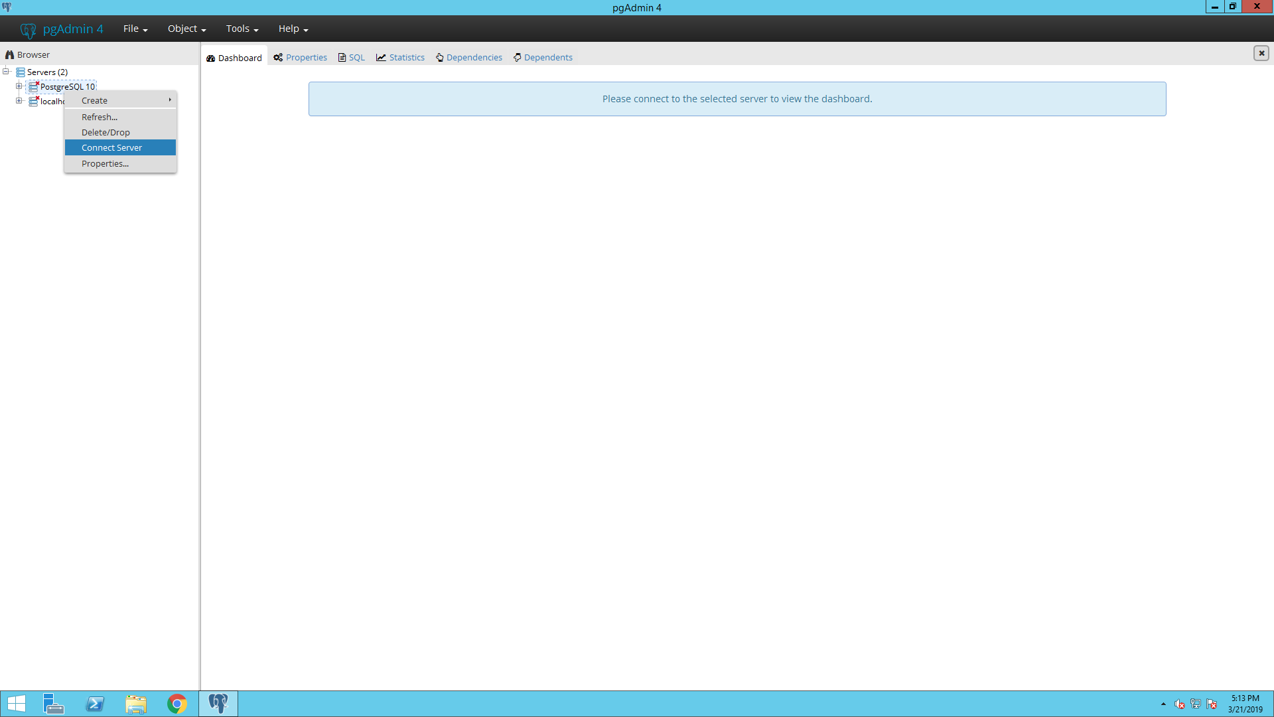
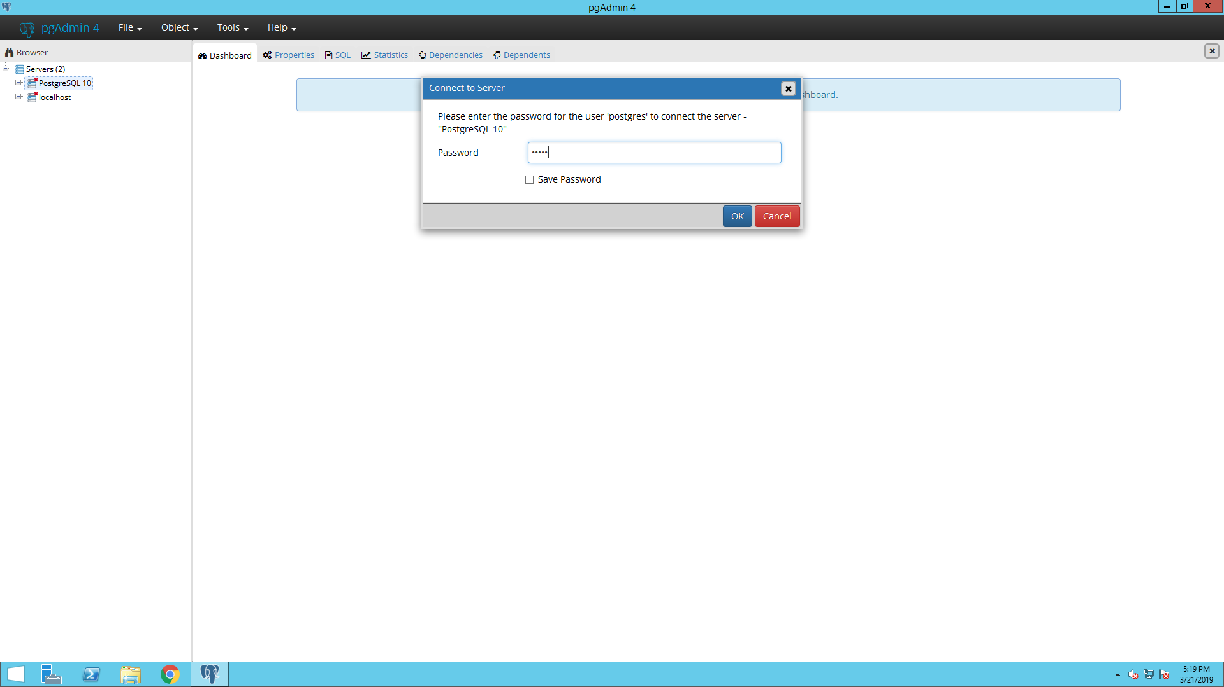
Mapping Source Codes – Your turn
Let’s open PostgreSQL
Open up pgAdmin4 using the icon on the task bar
Expand the server list and right-click on PostgreSql 10 and choose Connect Server from the drop-down menu
When it asks for a password, type in ohdsi

Slide 60
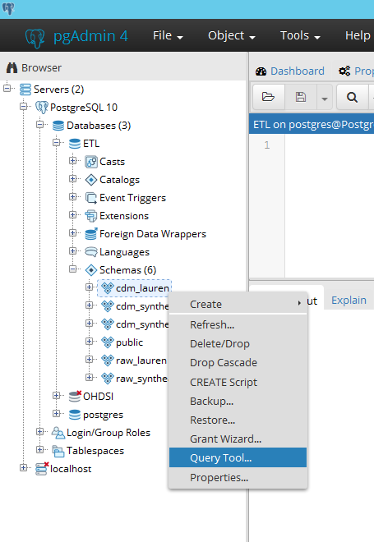
Mapping Source Codes – Your turn
Expand:
Databases
ETL
Schemas
Right click on cdm_synthea and choose Query Tool from the drop-down menu

Slide 61

Mapping Source Codes – Your turn
CODE | DESCRIPTION | CODE TYPE
C83.3 | Diffuse large B-cell lymphoma | ICD10 (not ICD10CM)
?
?
CONDITION_CONCEPT_ID | CONDITION_SOURCE_CONCEPT_ID
https://github.com/OHDSI/Tutorial-ETL/tree/master/materials/Queries

Slide 62
Mapping Source Codes – Your turn
CODE | DESCRIPTION | CODE TYPE
C83.3 | Diffuse large B-cell lymphoma | ICD10 (not ICD10CM)
?
?
CONDITION_CONCEPT_ID | CONDITION_SOURCE_CONCEPT_ID
44808122 | 45600549
https://github.com/OHDSI/Tutorial-ETL/tree/master/materials/Queries

Slide 63
Usagi
When the Vocabulary does not have your source codes you will need to create a map to OMOP Vocabulary Concepts
Usagi is Japanese for rabbit and was named after the first mapping exercise it was used for; mapping source codes used in a Japanese dataset into OMOP Vocabulary concepts
Usagi software tool to help with process of mapping source codes to OMOP concepts
Usagi performs text similarity between your source codes and what is in the OMOP Vocabulary

Slide 64
Usagi Process
Get a copy of the Vocabulary from ATHENA
Download Usagi
Have Usagi build an index on the Vocabulary
Load your source codes and let Usagi process them
Review and update suggest mappings with someone who has medical knowledge
Export codes into the SOURCE_TO_CONCEPT_MAP

Slide 65
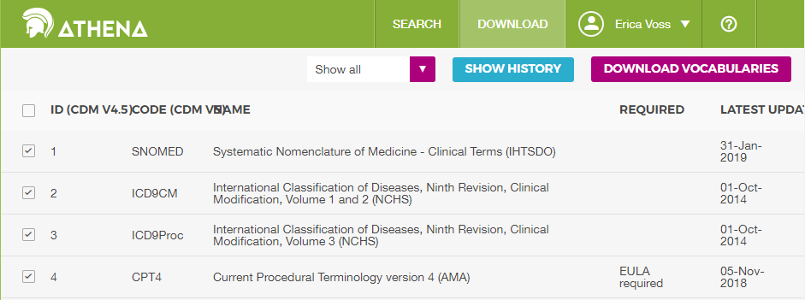
Usagi Process
1. Get a copy of the Vocabulary from ATHENA
http://athena.ohdsi.org

Slide 66
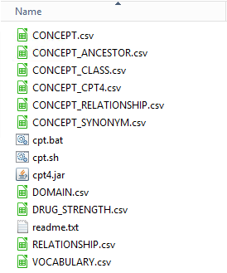
Usagi Process
1. Get a copy of the Vocabulary from ATHENA

Slide 67
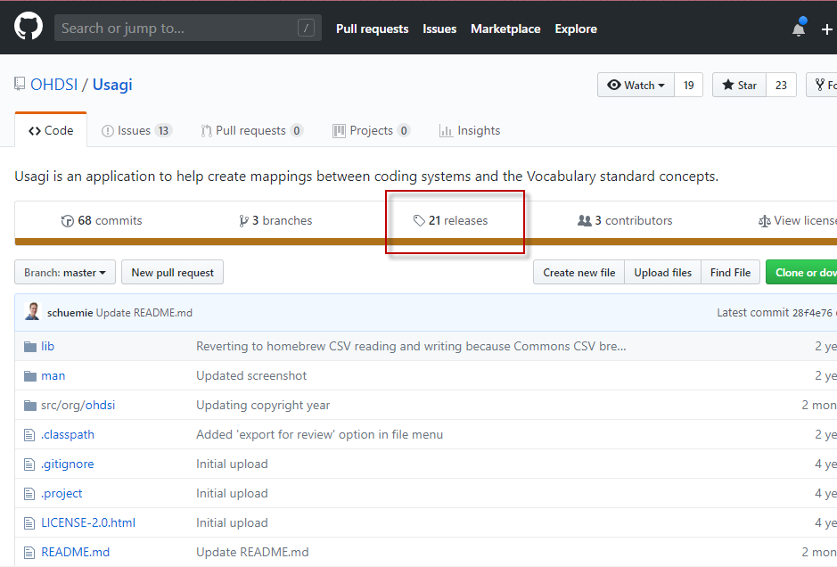
Usagi Process
2. Download Usagi
https://github.com/OHDSI/Usagi

Slide 68
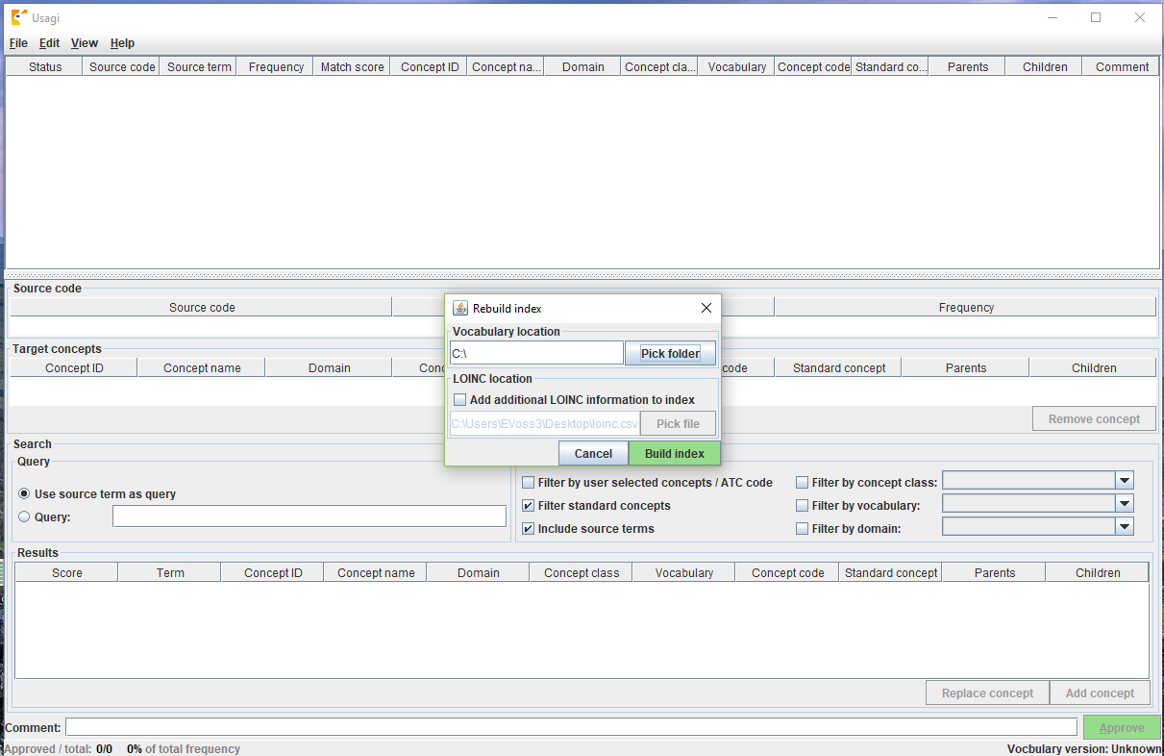
Usagi Process
3. Have Usagi build an index on the Vocabulary

Slide 69
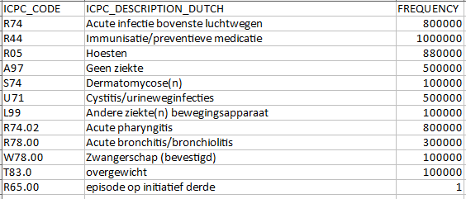
Usagi Process
4. Load your source codes, let Usagi process them
Generate an XLSX of distinct codes from source system with descriptions and frequency
If the codes are not in English, use Google Translate to convert

Slide 70
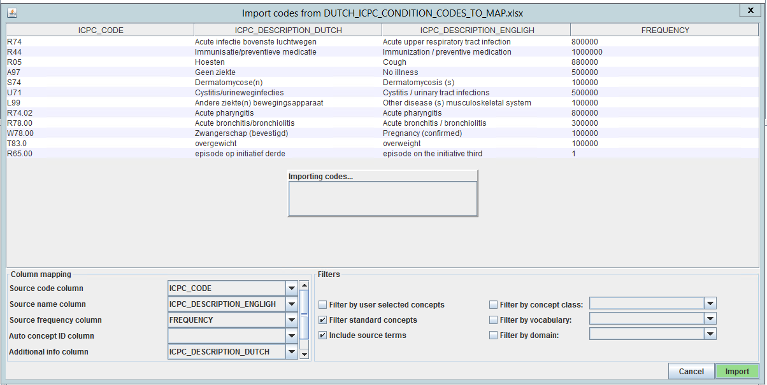
Usagi Process
4. Load your source codes, let Usagi process them
Import the codes into Usagi

Slide 71
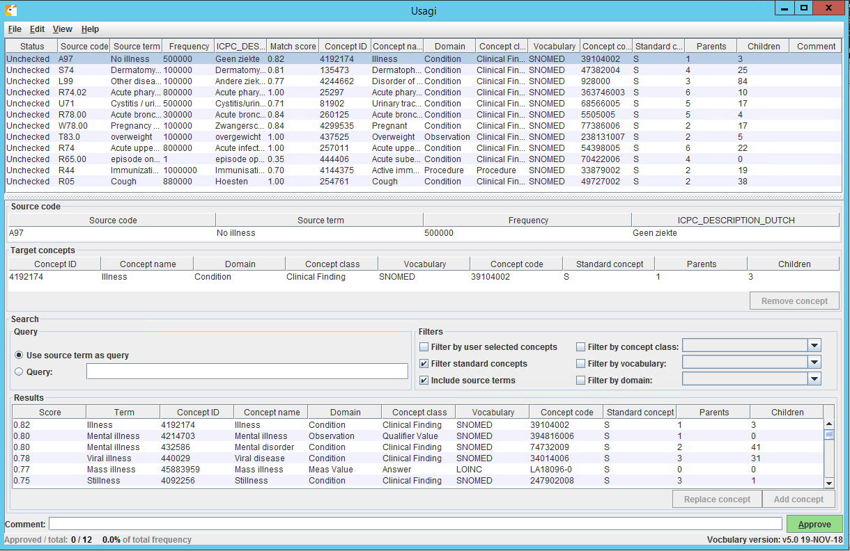
Usagi Process
5. Review and update suggest mappings with someone who has medical knowledge

Slide 72
Usagi Process
5. Review and update suggest mappings with someone who has medical knowledge

Slide 73
Usagi Process
5. Review and update suggest mappings with someone who has medical knowledge

Slide 74
Usagi Process
5. Review and update suggest mappings with someone who has medical knowledge

Slide 75
Usagi Process
5. Review and update suggest mappings with someone who has medical knowledge
It is okay to map to zero or 0 – “No matching concept”
A source code might end up being mapped to two concepts
You might have what the system considers one domain but the OMOP Vocabulary lumps into another domain

Slide 76
Usagi Process
6. Export codes into the SOURCE_TO_CONCEPT_MAP
After you have completed, you will export the relationships
When exporting you will give a Vocabulary ID, for example JNJ_JMDC_PROVIDERS would signify a Johnson & Johnson map for the database JMDC for provider codes.
R74.02 - Acute pharyngitis = 25297 - Acute pharyngitis
source_ code | source_ concept_id | source_ vocab_id | source_ code_ description | target_ concept_ id | target_ vocab_id | valid_ start_date | valid_ end_ date | invalid_ reason
R74.02 | 0 | TEST_ VOCAB | Acute pharyngitis | 25297 | SNOMED | 1/1/1970 | 12/31/2099

Slide 77
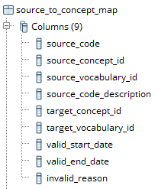
Usagi Process
6. Export codes into the SOURCE_TO_CONCEPT_MAP
You then load your generated maps into the empty Vocabulary table.

Slide 78

Usagi – Your Turn
Get a copy of the Vocabulary from ATHENA
Download Usagi
Have Usagi build an index on the Vocabulary
Load your source codes and let Usagi process them
Review and update suggest mappings with someone who has medical knowledge
Export codes into the SOURCE_TO_CONCEPT_MAP

Slide 79
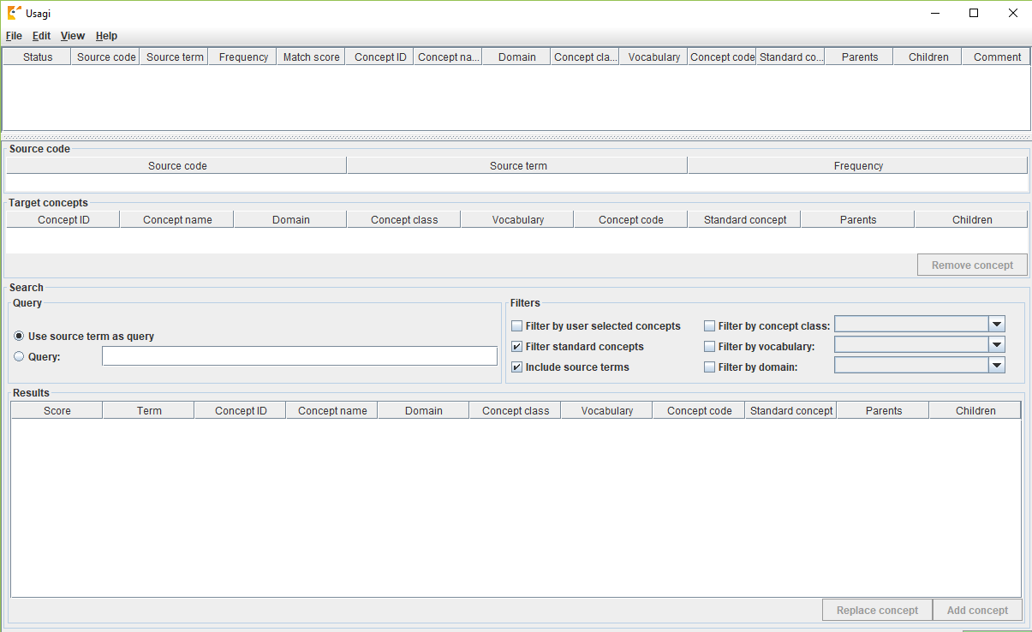
Now Your Turn: Open Usagi
Click on Usagi shortcut
Go into the Usagi-1.1.6 folder
Open Usagi.jar

Slide 80
Usagi – Your Turn
We have provided a small subset of codes to try to map
https://github.com/OHDSI/ Tutorial-ETL/
-> Materials -> Usagi -> DUTCH_ICPC_CONDITION_CODES_TO_MAP.xlsx
These condition codes are in Dutch ICPC codes and need to be mapped to standard concepts

Slide 81
Usagi – Your Turn
Your mission:
Download the codes to map
Translate codes to English
Import codes into Usagi
Map to standard concepts
Export SOURCE_TO_CONCEPT_MAP table
For help review the User Guide:
http://www.ohdsi.org/web/wiki/doku.php?id=documentation:software:usagi

Slide 83




ETL Implementation
There are multiple tools available to implement your ETL
In this example we created a builder using SQL and R, though your choice will largely depend on the size and complexity of the ETL design

Slide 84
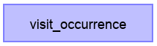
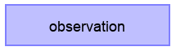
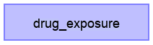
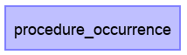
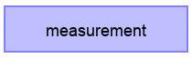
ETL Implementation
General Flow of Implementation
A good rule of thumb is to always create the PERSON table first
The VISIT_OCCURRENCE table must be created before the standardized clinical data tables as they all refer to the VISIT_OCCURRENCE_ID
Additional clinical data tables…
Notes:
It is a good idea to create the dimensional tables (PROVIDER, LOCATION, CARE_SITE) at the same time as PERSON

Slide 85
CDM Version 6 Key Domains
Person
Standardized health system data
Standardized metadata
Observation_period
CDM_source
Location
Standardized vocabularies
Visit_occurrence
Metadata
Location_history
Visit_detail
Standardized derived elements
Care_site
Condition_occurrence
Provider
Drug_exposure
Concept
Procedure_occurrence
Vocabulary
Device_exposure
Condition_era
Standardized clinical data
Domain
Drug_era
Measurement
Concept_class
Dose_era
Note
Standardized health economics
Concept_relationship
Results Schema
Note_NLP
Cohort
Relationship
Survey_conduct
Cohort_definition
Concept_synonym
Observation
Concept_ancestor
Specimen
Cost
Source_to_concept_map
Fact_relationship
Payer_plan_period
Drug_strength

Slide 86
ETL Implementation
Together
On your Own
In this example we will not go over the VISIT_OCCURRENCE creation, though a link to how that was done will be provided later in the presentation.

Slide 87
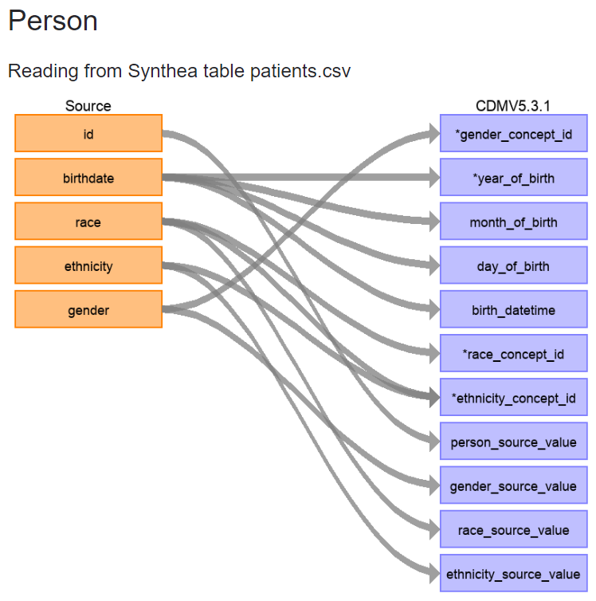
ETL Implementation
First, let’s review the logic we decided on for how the PERSON table should be created.
Navigate in your browser to: https://ohdsi.github.io/ETL-Synthea/Person.html

Slide 88
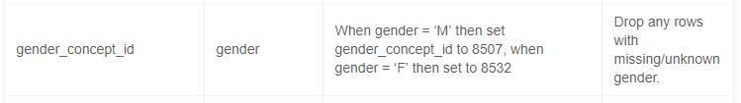
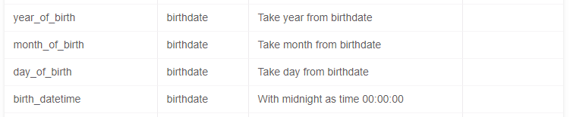
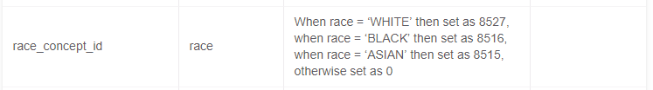
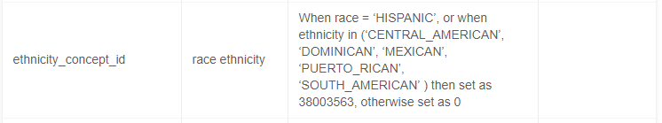
ETL Implementation
First, let’s review the logic we decided on for how the PERSON table should be created.
Gender:
Birthdate:
Race:
Ethnicity:

Slide 89
ETL Implementation
How should the PERSON table logic be implemented in SQL?
To open the query while we review:
https://github.com/OHDSI/Tutorial-ETL
Materials → Implementation→ Insert_Person_Lauren.sql
You can either view it directly in GitHub or download it and open it in pgAdmin4

Slide 90
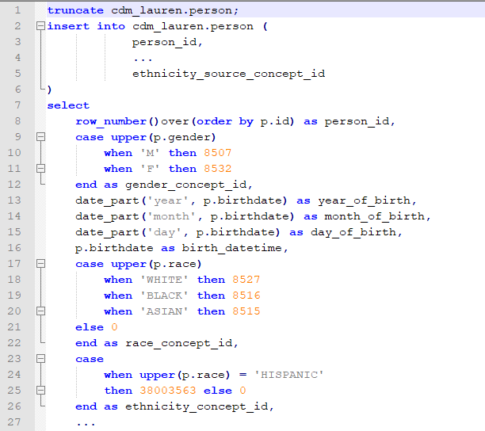
ETL Implementation
How should the PERSON table logic be implemented in SQL?

Slide 91
ETL Implementation
Let’s review the logic we decided on for how the PERSON table should be created.
Gender:
Birthdate:
Race:
Ethnicity:

Slide 92
ETL Implementation
How should the PERSON table logic be implemented in SQL?
Gender
Notes:
What is missing from the gender portion in the sql code?

Slide 93
ETL Implementation
How should the PERSON table logic be implemented in SQL?
Gender
??

Slide 94

ETL Implementation
How should the PERSON table logic be implemented in SQL?
Gender
??

Slide 95
ETL Implementation
Let’s review the logic we decided on for how the PERSON table should be created.
Gender:
Birthdate:
Race:
Ethnicity:

Slide 96
ETL Implementation
How should the PERSON table logic be implemented in SQL?
Birthdate

Slide 97
ETL Implementation
How should the PERSON table logic be implemented in SQL?
Birthdate
??

Slide 98
ETL Implementation
Let’s review the logic we decided on for how the PERSON table should be created.
Gender:
Birthdate:
Race:
Ethnicity:

Slide 99
ETL Implementation
How should the PERSON table logic be implemented in SQL?
Race

Slide 100
ETL Implementation
Let’s review the logic we decided on for how the PERSON table should be created.
Gender:
Birthdate:
Race:
Ethnicity:

Slide 101
ETL Implementation
How should the PERSON table logic be implemented in SQL?
Ethnicity
??

Slide 102
ETL Implementation
Now let’s run the code and create the PERSON table in the cdm_lauren schema
1. Download the query from:
https://github.com/OHDSI/Tutorial-ETL
Materials → Implementation→ Insert_Person_Lauren.sql
2. Open up pgAdmin4 using the icon on the task bar
Notes:
Open up pgAdmin 4 on the VM

Slide 103
ETL Implementation
Expand the server list and right-click on PostgreSql 10 and choose Connect Server from the drop-down menu
When it asks for a password, type in ohdsi

Slide 104
ETL Implementation
Expand:
Databases
ETL
Schemas
Right click on cdm_lauren and choose Query Tool from the drop-down menu

Slide 105

ETL Implementation
Paste the sql code to create the PERSON table into the query window and press F5 or
NOTE:
The ‘truncate’ statement at the beginning deletes anything that is in the table already without deleting the table itself (helpful if you make a mistake)
How would you check that your PERSON table was created?

Slide 106

ETL Implementation
First, let’s review the logic we decided on for how the CONDITION_OCCURRENCE table should be created.
Navigate in your browser to: https://ohdsi.github.io/ETL-Synthea/Condition_occurrence.html

Slide 107



ETL Implementation
First, let’s review the logic we decided on for how the CONDITION_OCCURRENCE table should be created.
Person:
Condition Concept:
Condition Source Concept:

Slide 108
ETL Implementation
How should the CONDITION_OCCURRENCE logic be implemented in SQL?
To open the query while we review:
https://github.com/OHDSI/Tutorial-ETL
Materials → Implementation→ Insert_Condition_Occurrence_Lauren.sql
You can either view it directly in GitHub or download it and open it in pgAdmin4

Slide 109


ETL Implementation

Slide 110


ETL Implementation
How should the CONDITION_OCCURRENCE logic be implemented in SQL?

Slide 111
ETL Implementation
How should the CONDITION_OCCURRENCE logic be implemented in SQL?
??
Notes:
Explain the persistent table for the vocab_map
Left join to that table, why it is necessary
The choice to represent NULL concept_ids as 0

Slide 112

ETL Implementation
How should the CONDITION_OCCURRENCE logic be implemented in SQL?

Slide 113
ETL Implementation
Now let’s run the code and create the CONDITION_OCCURRENCE table in the cdm_lauren schema
Download the query from:
https://github.com/OHDSI/Tutorial-ETL
Materials → Implementation→ Insert_Condition_Occurrence_Lauren.sql
NOTE: Make sure you have created the PERSON table in the cdm_lauren schema or this sql script will not work
Notes:
Open up pgAdmin 4 on the VM

Slide 114
ETL Implementation – Your Turn
Review the OBSERVATION_PERIOD logic
https://ohdsi.github.io/ETL-Synthea/Observation_period.html
2. Think through how that could be represented using SQL
Note: If you are not a SQL programmer don’t worry! Feel free to use this time to explore the Achilles tool through the browser at http://localhost/achilles/#/Synthea/dashboard

Slide 115

ETL Implementation – Your Turn
https://github.com/OHDSI/Tutorial-ETL
Materials → Implementation→ Insert_Observation_Period_Lauren.sql

Slide 116
ETL Implementation – Your Turn
https://github.com/OHDSI/Tutorial-ETL
Materials → Implementation→ Insert_Observation_Period_Lauren.sql

Slide 117
Resources
The full Synthea builder can be found here:
https://github.com/OHDSI/ETL-Synthea
Another example of a R/SQL builder for a much larger database:
https://github.com/OHDSI/ETL-HealthVerityBuilder
A builder created using .NET:
https://github.com/OHDSI/ETL-CDMBuilder
A builder created using the AWS lambda functionality:
https://github.com/OHDSI/ETL-lambdabuilder
(in development)

Slide 118
ETL Implementation - Advanced Topics
VISIT_OCCURRENCE logic
Use of chunking for large databases
Use and creation of intermediate tables

Slide 120


Quality
What tools are available to check that the CDM logic was implemented correctly?
Achilles HEEL
Rabbit-in-a-Hat Test Case Framework

Slide 121
Achilles
Achilles is a data characterization and quality tool available for download here:
https://github.com/OHDSI/Achilles
For an example of how it was run for our sample data, that R script is located here:
https://github.com/OHDSI/Tutorial-ETL/blob/master/materials/Achilles/achillesRun.R
Notes:
Pull up achilles on the VM to explore

Slide 122

Achilles

Slide 123

Achilles Heel
Achilles heel is a report generated by the Achilles application that will run a series of data quality checks on the CDM

Slide 124

Unit Test Cases
Rabbit-in-a-Hat
The application has a feature called ‘Generate ETL Test Framework’. This feature allows you to create ‘fake’ people as a way to test your ETL logic.

Slide 125

Unit Test Cases
The test framework creates a series of R functions that enables you to specify your ‘fake’ people and records in the same structure as your source data using the scan report as a guide.

Slide 126
Unit Test Cases
An example of how this was done for the Synthea data is available from:
https://github.com/OHDSI/Tutorial-ETL/tree/master/materials/Unit%20Tests
The file that creates the test cases as a series of insert statement is RunSyntheaTestCases.r
Notes:
Pull up the test cases on the VM

Slide 127

Unit Test Cases
Let’s revisit the PERSON table logic:
How could we create a test case for this?
Notes:
Pull up the test cases on the VM, this can be for reference

Slide 128


ETL Maintenance
ETL Documentation
Changed or Updated Raw Data?
ETL
Bug Found?
Updated CDM
New Vocab?
All are involved in quality control
A technical person implements the ETL
CDM Update?

Slide 129
ETL Maintenance
Let’s Revisit
Ethnicity
??

Slide 130

Final Hard Lessons Learned

Slide 131


80/20 Rule
You don’t need to map all terms to get good data coverage!

Slide 132
Comfort with Data Loss
If there is data that is not of research quality or there are methods to adjust, use the ETL to standardize that
Example Patient Drop Counts from a CDM Build
Reason to Drop Someone | Person Count
Unknown gender | 23,592
Implausible year of birth - past | 749
Implausible year of birth - post earliest observation period | 3,836
Gender changes | 2

Slide 133


Thank you!
This tutorial would not have been possible without the contribution of many collaborators in the OHDSI Community
We like to thank Amazon Web Services for their valuable technical support and resources

Slide 134



Acknowledgements
Anthony Molinaro who wrote the Synthea CDM Builder
James Wiggins who helps us prepare an AWS instance for use today
Pusheen the Cat
http://pusheen.com/

Slide 135

Notes:
Use this slide for advanced questions

